Slide 1
10 TECH COMPANIES

Slide 2
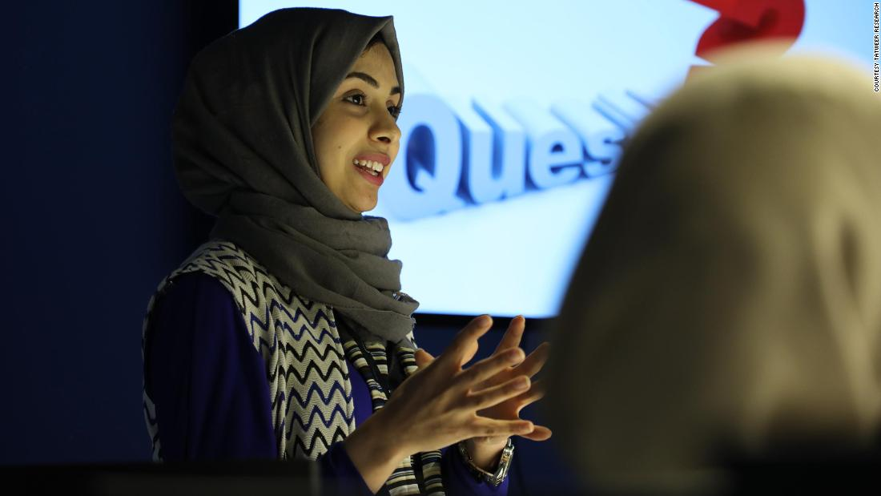
1.PLUS
Founder-Hala Haitham.
A medical app.
Helps patients diagnose symptom of disease.
Reminds users of medications.

Slide 3
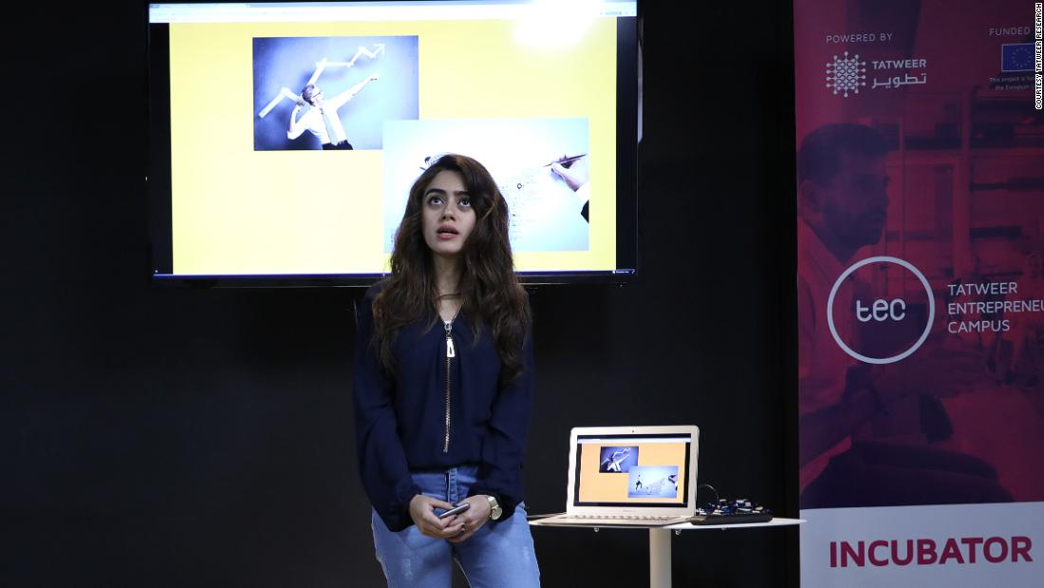
2.ARTOPIA
Co founder Laila Adam.
Combination of AR painting and real world discovery.
Created to improve the density of art on the internet.

Slide 4
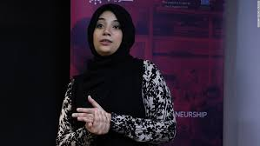
3.SCHOOL CONNECT.
F
Is an app that allows parents ; track , monitor and follow up children’s progress.
Founders Hala Haitham and Tafaha Asheed.
Advantages
Messages.
Reports.
Sons.
Advertising.

Slide 5

4.WAJABAT ONLINE.
Is a food delivery startup.
Serves both restaurants and merchants deliver food to customers.
Deals with take away foods from local restaurants.

Slide 6

5.DONUT HOME.
Is a food and beverage company.
Founded by members of Tatweer research group.
Was the first donut home in Libya.

Slide 7
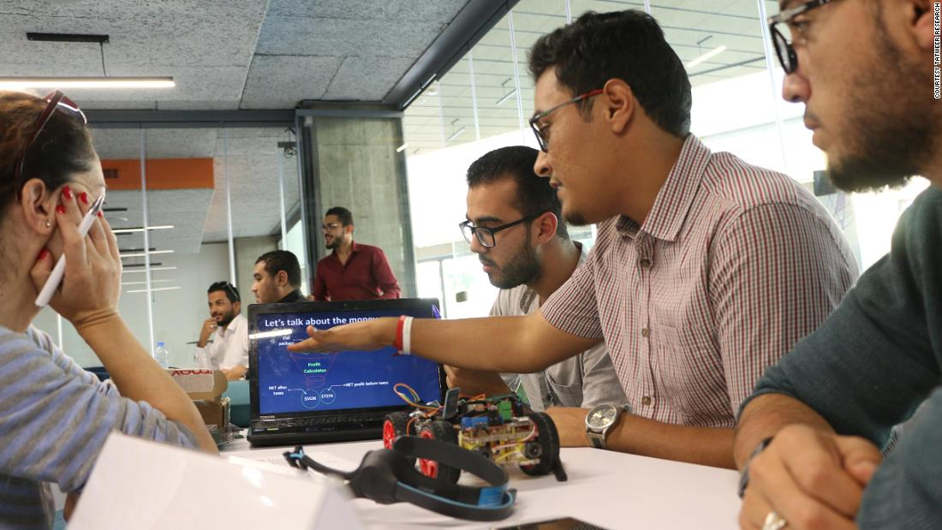
6.U THINK U MOVE.
Focuses on those with disabilities.
Came up with a special helmet.
Transmits signals from one’s brains to a high tech wheelchair.
Signals are translated to direct movement.

Slide 8

7.ELHAM INSPIRE.
Best startup in Libya.
Founder and CEO is Mallek Ajaj.
Offers training in web development ,game development etc.
Furnishes teenagers with soft skills training.
Used in schools.

Slide 9
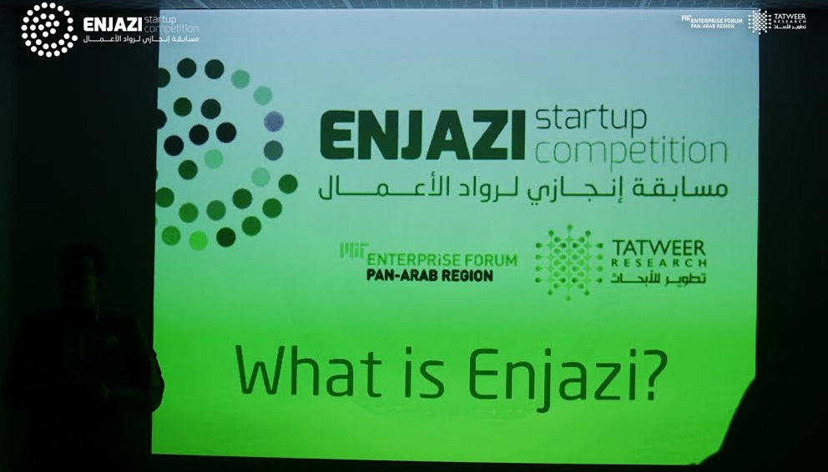
8.ENJAZI COMPETITION.
Partners with Taweer research and enterprise forum Pan Arab Region.
Is a startup.
Offers entrepreneurship competition.
Aims to empower entrepreneurs with ideas and startups.
Offers value adding employment.

Slide 10

9.LIBYA CROWDFUNDER.
Founded by Disrupt Africa.
Has access to capital and education.
Helps startups raise funds to support their ventures.

Slide 11
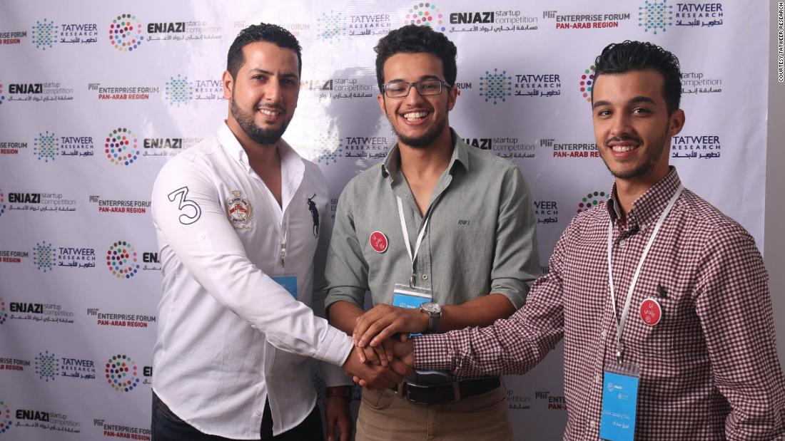
10.GAMERS UNITE.
Founders are Salem Ali Elsaih.
Gamer-one who plays and devises video games.
Is a game development hackathon.
Enables people to create their own games.

Slide 12

11.CONCLUSION
Energy and persistence conquer everything.
Written by:
Akoth Sharon.

